Slide 1
New Service Development
Chapter 5

Slide 2
New Service Development Cycle
Execution Stage
Planning Stage
Full Launch
Design
People
Products
Tech-
nology
Systems
Develop-ment
Analysis

Slide 3
Service Innovation
Radical Service Innovation
  Requires a different process and design approach than incremental innovation
  Innovative service firms require enablers to facilitate the process
  Nature of change will dictate where resources are allocated
  Radical innovations imply increased risk and resource investment

Slide 4
Service System Design
Service Decision Factors
  Facility Location (based upon proximity to customers)
  Facility Layout (depends on the presence of the customer at the location)
  Product and Process Design (Covers both the intangible and tangible aspects of the service offering)

Slide 5
Service System Design
Service Decision Factors (continued)
  Scheduling (how the workers are assigned to the service)
  Worker Skills (depend on service strategy and concept, customer contact level and industrialization level)
  Quality Control, Measures and Time Standards (focus is on the needs of the customer)

Slide 6
Service System Design
Service Decision Factors (continued)
  Demand/Capacity Planning (depends on the type of service and the immediacy of matching supply to demand)
  Industrialization (the substitution of technology for people)
  Standardization of Service Offering (level of uniformity provided in the service)

Slide 7
Service System Design
Service Decision Factors (continued)
  Customer Contact Level (physical presence and length of time that a customer spends with a service provider)
  Front Line Personnel Discretion (denotes the flexibility of the service employee while interacting with a customer)
  Sales Opportunities (coincide with high customer contact and employee discretion)
  Customer Participation (substitution of consumer labor for provider labor)

Slide 8
Service System Design and Innovation
Supporting facilities must be in place prior to offering a service
Facilitating goods such as a product or other tangible features are part of the service
Sensual and psychological benefits are associated with the service offering

Slide 9
Service System Design and Innovation
Services might be bundled into one supporting facility
Must differentiate between core and ancillary services

Slide 10
Service System Design and Innovation
Industrialization Level
Low
Face to Face Delivery
Telephone or Courier Delivery
Current Service
Incremental Service Innovation
Technology Based Self-Service
Technology-Driven Service Innovation
Radical Service Innovation
High
Low
High
Standardization of Service Offering

Slide 11
Service System Design Tools: Service Blueprinting
Design tool based on the process flow diagram
  Delineate front office from back office operations
  Determine standard or maximum execution times, materials and the exact process for each step
  Identify potential failure points and generate mitigation plans to prevent or recover from a failure

Slide 12
Service System Design Tools: Service Blueprinting
Service Blueprint for Espresso and Coffee Shop
Seen by customer
Take Drink Order
Collect Payment
Make Drink
Deliver Drink
Fail Point
Materials
(Coffee, flavors, milk, cups, etc.)
Line of Visibility
Prepare Mixes
Order Supplies
Not seen by customer

Slide 13
Service System Design Tools: Customer Utility Models
Success depends upon customer’s perceived utility or benefit provided by the service’s price or non-price attributes
Promise of customer utility measurement is the ability to optimize the design of a service
Satisfaction with the quality of service affects customer loyalty and repurchase intent

Slide 14
Service System Design Tools: Customer Utility Models
Service quality can be measured along five principle dimensions:
  Reliability
  Responsiveness
  Assurance
  Empathy
  Tangibles

Slide 15
Service System Design Tools: Customer Utility Models
Improving reliability can result in increased labor and training costs
Responsiveness may be enhanced by reducing queue times
Empathy and assurance can be influenced by the ability of service providers to convey knowledge, courtesy and impressions of caring
Enhancing the tangible attributes of a service increases costs of consumables

Slide 16
Service System Design Tools: Customer Utility Models
Conjoint analysis (CJA) and discrete choice analysis (DCA) are used to model customer behavior
  Discrete choice experiments involve careful design of service profile choice sets
  Design of a new airport restaurant requires the following
    Identification of important attributes
    Specification of attribute levels
    Experimental design
    Presentation of alternatives of respondents
    Estimation of choice model

Slide 17
New Service Design for
Snowbird Ski Resort
Determine Appropriate Service Attributes
(e.g., Price, Service Time, Intangible, & Tangibles)
Determine all variables and costs related to Service Attributes
& demand -capacity matching strategies
Collect Customer Attribute Information using choice-based or ratings-based conjoint analysis
Solve for Customer Segments and Utility Weights (βs)
using multinomial Logit or regression analysis
Profile N with attributes,
price, and cost
Customer waiting time
Queuing Models
or Simulation
Feasibility Evaluate Market Share & Profit
& Profit

Slide 18
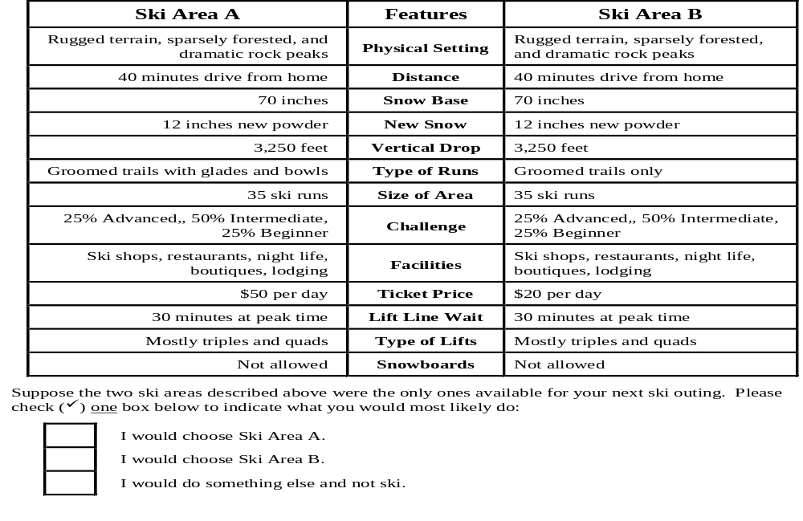
New Service Design for
Snowbird Ski Resort

Slide 19
Chapter Summary
New service design poses many challenges
due to
  Intangible nature of service encounters
  Inability to prototype and test new concepts
  Propensity to use ad hoc methods
Innovations come through both incremental and radical new services

Slide 20
Chapter Summary
Service design tools assist designers in evaluating service concepts for improved
  Efficiency
  Customer Satisfaction
  Quality
  Market Share
  Profitability

